Slide 1
JOURNEY PRESENTATION
AKSHAY P

Slide 2
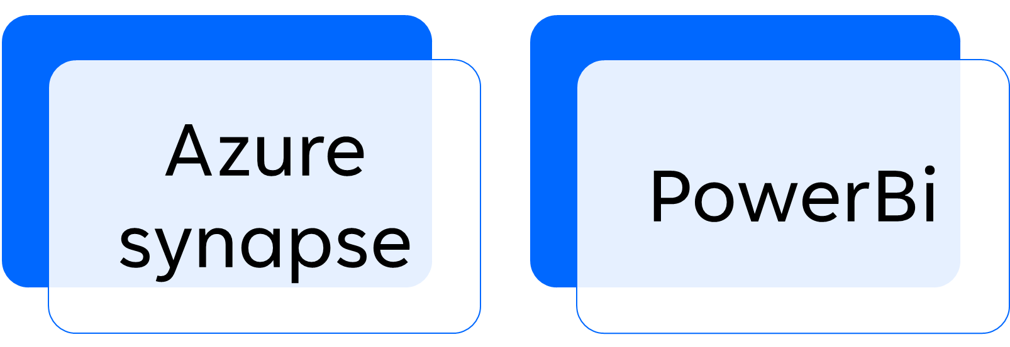
Agenda

Slide 3
Azure Synapse
Azure Synapse Analytics is a cloud-based analytics service offered by Microsoft Azure. It integrates data from different sources and provides a managed data warehousing solution for analyzing large volumes of structured data.
It's part of the Azure data services ecosystem, making it a powerful tool for data analytics and insights.

Slide 4
Basics
When to use synapse
Serverless SQL pool
Need for a managed service
When u have large dataset and complex queries
Manage structured and unstructured data set
Data pipeline orchestration
Analytics on real-time operational data
Serverless SQL pool
Pay as u go model
Dedicated compute resources which allow u control and optimize performance using DWU

Slide 5
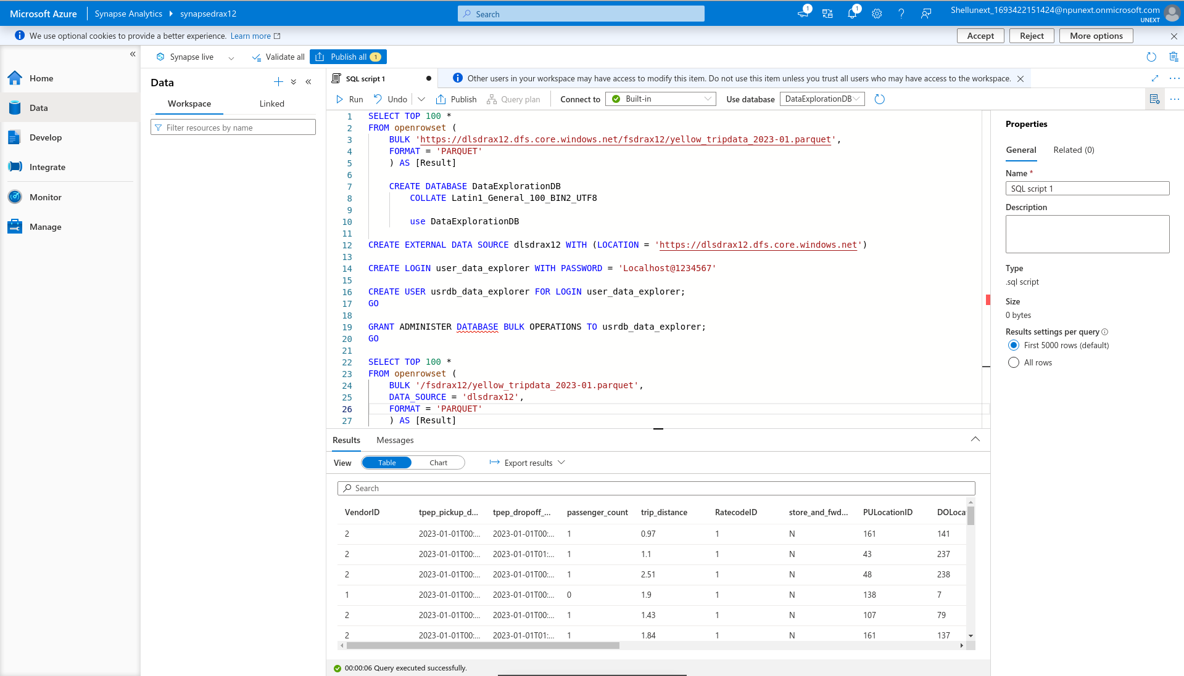
Develop

Slide 6
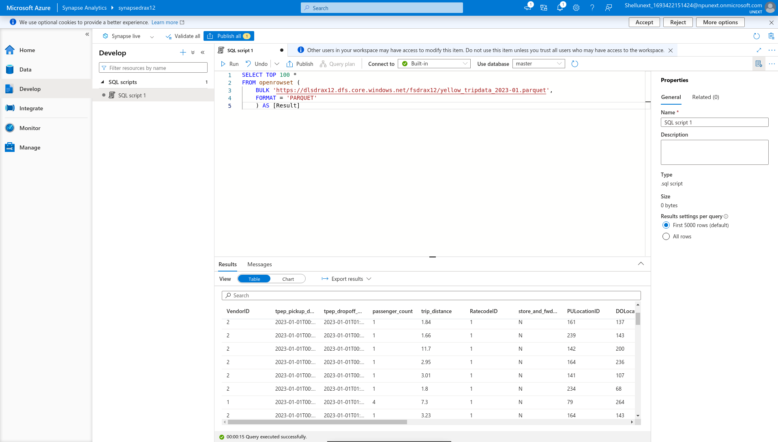

Slide 7
Power BI
Power BI is a business intelligence and data visualization tool developed by Microsoft. It enables users to connect to various data sources, transform and clean data, and create interactive reports and dashboards. Power BI is known for its user-friendly interface and robust capabilities for data exploration and analysis.
Key features include data modeling, DAX (Data Analysis Expressions) for creating calculated measures and columns, a wide range of visualizations, and the ability to publish reports to the Power BI service for sharing and collaboration. It is widely used for data-driven decision-making in organizations, helping users gain valuable insights from their data.

Slide 8
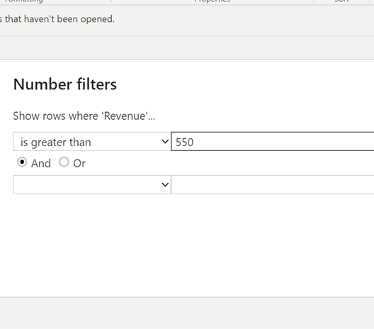
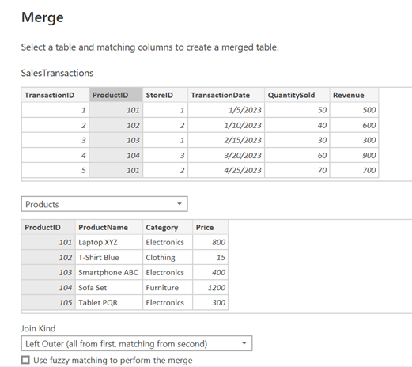
Basic operations
Merge
Filter

Slide 9
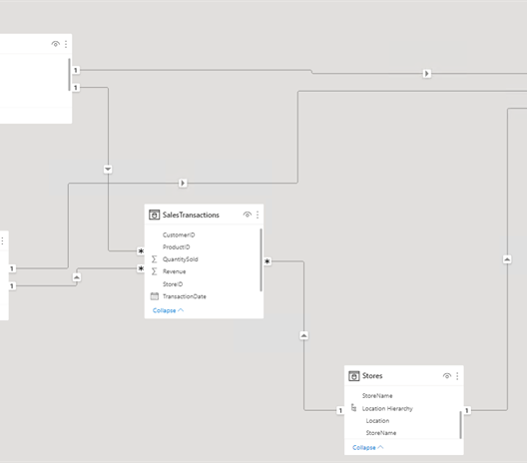
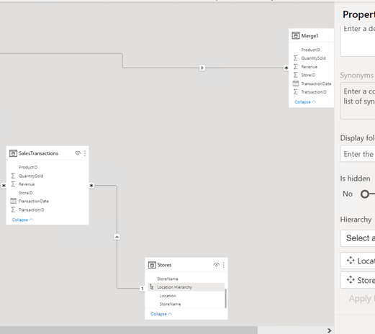
Data Modelling
Creating Relations
Creating Hierarchy

Slide 10
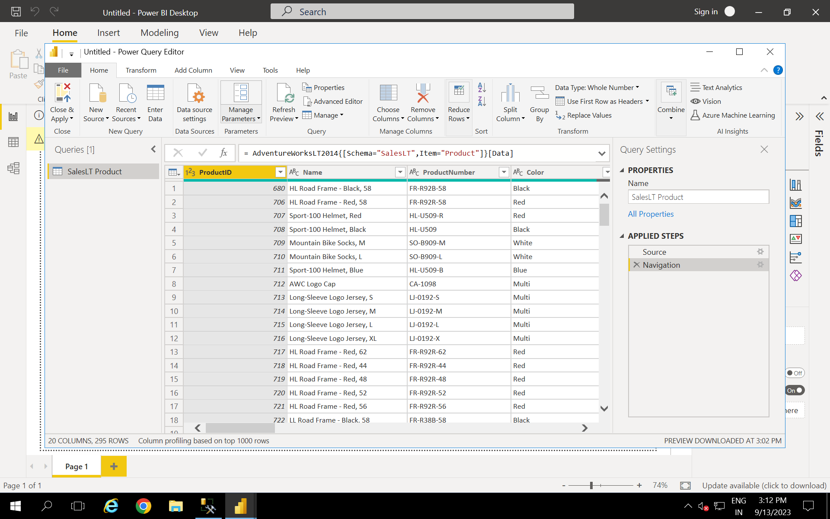

Slide 11
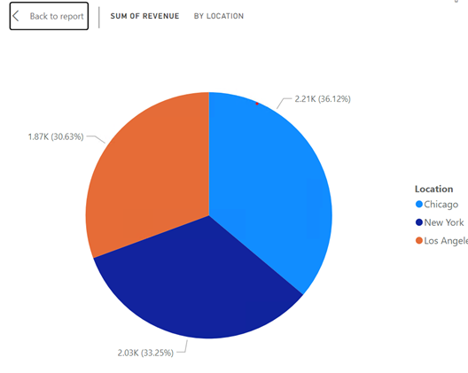
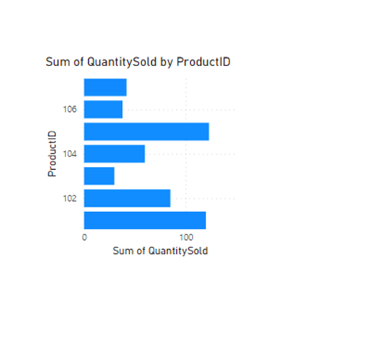
Visualizations
Location wise revenue
Quantity vs product

Slide 12
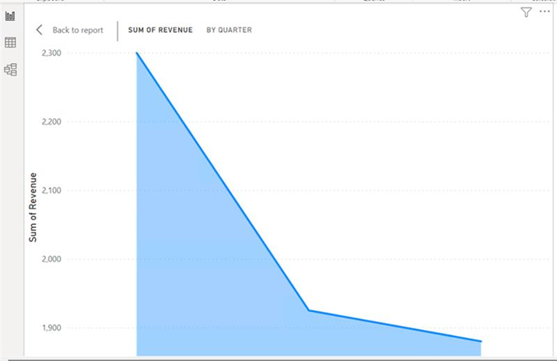
Revenue by Quarter

